Slide 1
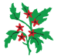

Special Educational Needs and Disabilities at Hawthorn Community Primary School
‘Cultivating the futures of our children’
SEN INFORMATION REPORT – September 2025
Your questions answered.
Inclusion Leader and Inclusion Leader : Mrs Frances Martin fmartin@hawthorn.pfschools.org.uk
School Family Support Worker: Siobhain Larkin slarkin@hawthorn.pfschools.org.uk
Governor with SEND Responsibility:

Slide 2
What are the different areas of need at Hawthorn Primary School?
We support learners across the four areas of need:
Communication and Interaction
Cognition and Learning
Social, Emotional and Mental Health
Sensory/Physical

Slide 3
What do we provide at Hawthorn for SEND learners?
An understanding of SEND.
Inclusion for ALL pupils.
Full access to a broad and balanced curriculum.
A school Inclusion Leader/Qualified SENDCo
Maximum opportunities to achieve at the national standard.
Precise, evidence based and planned interventions.
An understanding of SEND and underachievement.
Support to narrow attainment gaps and maximise progress of learners.
Individual targets to support progress with termly reviews.
Appropriate support materials, and equipment, to meet individual needs.
Honest and open communication between home and school.
A one page profile for all learners.
Evidence based teaching strategies which promote inclusion for all.
Regular SEND Surgery to have professional dialogue and monitor progress

Slide 4
What SEND needs do we have at Hawthorn?
Where a medical need is present, unless the medical need impact on the child’s learning, they will have their needs met under the ‘Children with Medical Needs’ Policy. Medical needs do not automatically result in a child being added to the SEND register.
Autism Spectrum (ASD)
Attention Deficit Hyperactivity Disorder (ADHD)
Specific medical conditions impacting education
Physical difficulties
Wellbeing and social skills support
Hypermobility
Sensory processing difficulties
Social, emotional and mental health needs (SEMH)
Speech and language needs
Developmental co-ordination disorder
Global developmental delay
Dyslexia and specific literacy difficulties
Attachment

Slide 5
How do you decide whether a child has SEND?
We use the graduated approach to make decision about whether a child has SEND. We have 3 key steps we follow.
Step 1
We provide Quality First Teaching for all
This means we prioritise high quality, inclusive and adaptive teaching for all in our school.
What does this look like?
High expectations for every pupil
Clear learning intentions and success criteria.
Adaptive teaching and scaffolding
Strong subject and pedagogical knowledge.
Effective questioning and feedback.
Systematic teaching of vocabulary, reading, and writing.
Structured practice and retrieval to build fluency.
Positive relationships and emotionally safe classrooms.

Slide 6
How do you decide whether a child has SEND?
We use the graduated approach to make decision about whether a child has SEND. We have 3 key steps we follow.
Step 2
When a concern is raised, we talk about it and act.
Where there is a concern, the child is discussed at termly SEND Surgery (6 times a year) with the Phase Leader and the Inclusion Leader. If parent raises concern, teacher informs parent that they will be discussed at our surgery and parents will be spoken to about our next steps. Their views are listened to and valued.
Discussions include:
What is the presenting need
What (if anything) has been tried so far and the effectiveness
Any parental views/history
Actions:
The initial actions agreed and recorded following the APDR cycle, with a review date set.
Actions and concerns are recorded on the SEND Surgery monitoring forms and the child’s individual chronology.
We consider screening questionnaires from SALT or OT to gather further information
Parents spoken to and actions shared
Note: In some cases, children may go straight to step 3 and have an IEP and 1PP in place at this stage. Decision made between Inclusion Leader, phase leader and teacher based on above discussion, taking into consideration history, progress and presentation of need.

Slide 7

How do you decide whether a child has SEND?
We use the graduated approach to make decision about whether a child has SEND. We have 3 key steps we follow.
Step 3
We review the action we’ve taken and the outcome.
Child is reviewed at the next SEND surgery with class teacher, Phase Leader and Inclusion Leader. Review includes:
  Progress since last discussion
  Strategies attempted and outcome
  Share parental voice
  If child has an IEP, review the targets including pupil voice
Through discussions with phase lead/teacher/parents and Inclusion Leader a next step decision is made. Either the child’s needs can be met through QFT (wave 1) or they require provision different from or additional to that normally available to pupils of the same age (wave 2) (SEND COP 2015)
Decision made: Progress made
If sufficient progress has been made and can be met through QFT, child remains monitored to ensure the progress continues but not added to the SEND register
Decision made: SEND need identified
Set up an IEP and 1PP and follow the APDR cycle
Add to the SEND register and inform parents
Observations if required by Inclusion Leader
Possible referral to outreach partners (Maplefields, Rowan Gate)
Consider Educational Psychologist Referral
Following 2/3x APDR cycle, consider EHCPNA when lead professional has been involved and there is a report. (wave 3). If there is a more complex need then a best fit judgement will be made.
Decision making

Slide 8
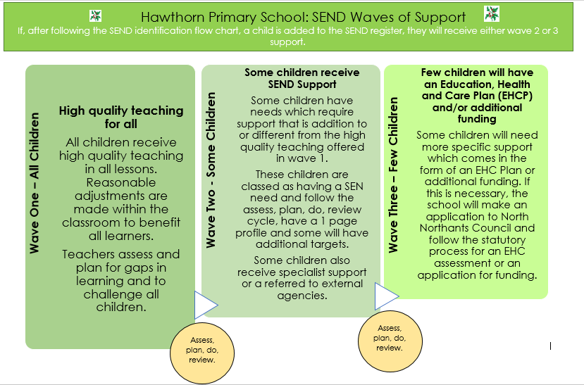

Slide 9
What are your waves of support?
Identification of SEND and added to the SEND register
Wave One – All Children
Wave Two - Some Children
Wave Three – Few Children
Some children receive SEND Support
Few children will have an Education, Health and Care Plan (EHCP) and/or additional funding
Some children will need more specific support which come in the form of an EHC Plan or additional funding. If this is necessary, the school will make an application to North Northants Council and follow the statutory process for an EHC assessment or an application for funding.
High quality teaching for all
All children receive high quality teaching in all lessons. Reasonable adjustments are made within the classroom to benefit all learners.
Teachers assess and plan for gaps in learning and to challenge all children.
Some children have needs which require support that is addition to or different from the high quality teaching offered in wave 1.
These children are classed as having a SEN need and follow the assess, plan, do, review cycle, have a 1 page profile and some will have additional targets.
Some children also receive specialist support or a referred to external agencies.
Assess, plan, do, review
Assess, plan, do, review

Slide 10
How do we plan for SEND learners at Hawthorn?
A Hawthorn Child
ASSESS A child is identified for additional support based on whole school monitoring and additional assessments.
PLAN Teaching staff and support staff used the evidence they have to plan effective and precise interventions for a child, which are underpinned by quality first teaching.
DO Quality first teaching combined with effectively planned interventions and high aspirations for all ensure that learners gaps are closed.
REVIEW A regular monitoring cycle provides robust opportunities to review progress and approaches towards targets and to plan next steps for the child.
Understanding which approaches secure the best outcomes
Gaining an understanding of learners needs.
Understanding what effective support looks like.
Gaining an understanding of what teaching strategies work.

Slide 11
How do we communicate with parents?
How do we support parents to help their child?
Termly targets and reviews shared with parents. Parental voice included.
One page profile shared with parents.
Assessment information shared 3 times a year.
Annual review held for children with EHC Plans.
Additional meetings/conversations with parents of children with emerging/complex needs. Open door policy.
Parent/school communication through Class as required.
Support offered though coffee afternoons and professionals invited to come and speak with parents.
Early Help offered by Family Support Worker and Inclusion Leader.

Slide 12
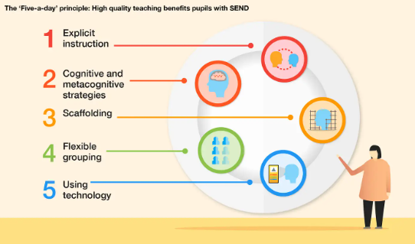
How do we provide high quality teaching to all children in the classroom?
As well as our Inclusion Policy, which explains what we do to support our children with SEND, we have a SEND Strategy. Our SEND Strategy was written to support all staff at Hawthorn and all staff have received training on this approach in September 2022. It outlines what you’d expect to see in all classrooms, it’s the Hawthorn Way!
Education Endowment Foundation, January 2022
The SEND Strategy is based on the Education Endowment Foundation’s
5-a-Day strategy for high quality teaching for all in the classroom.

Slide 13
What additional adjustments do we make for children at Hawthorn?
At Hawthorn School we recognise our that there are additional adjustments to the teaching and learning environments that will enable our learners to access the curriculum, linked to the 5-a-day strategy and which run alongside it.
These are the reasonable adjustments that you may see within our school. These are organised under the headings according to the SEND Code of Practice, however, it is recognised that some of these strategies fit more than one category. They are applied on a case-by-case basis following discussions between the Inclusion Leader and the class teacher.
Cognition and Learning
Differentiated curriculum and delivery
Communication and Interaction
Organised learning environments
Sensory and Physical
Calm classrooms to avoid overstimulation
Social, emotional and mental health
Accessible reading materials (fonts, size, colour)
Use of visual aids (word banks, number lines, manipulatives)
Frequent repetition of learning and retrieval exercises
Multisensory approaches to learning
Visually calm learning environments
Visual timetable for class
Key vocabulary explained
Clear learning objectives and success criteria
Use of models and WAGOLLS to communicate expectations
Opportunities for group and paired work
Talk time and take up time
Questioning that is varied by ability
Teacher modelling
Scaffolded independent work
TA and teacher supported tasks
Working walls with learning prompts
Clear and direct instructions
Individual timetables and checklists
Own workstation
Additional processing time
Use of models and WAGOLLS to communicate expectations
Key vocabulary explained
Clear learning objectives and success criteria
Talk time
Chunked learning
Group work and individual work
Social stories
Easy access to equipment
Carefully planned seating positions
Use of writing slopes, pencil grips and wobble cushions
Brain breaks
Coloured overlays and books
Sensory fidget toys/sensory objects
Use of ear defenders
Sensory fidget toys/sensory objects
Clear classroom rules
Clear rewards and sanctions
Time out and time away from the classroom
Safe spaces
Regular communication with parents
Timers
Structured routines
Consistent use of positive language
Emotion coaching approach
Keeping the child ‘in mind’ – regular check ins
Use of interventions:
Anxiety
Anger
Self-esteem
Social skills
Managing and labelling emotions
1:1 and drop in time with Family Support Worker

Slide 14
Who supports children in the classroom at Hawthorn?
All children are supported by their class teacher and at least teaching assistant. Some classes have additional support from teaching assistants depending on the needs in the class. Our aim is always to support children whilst promoting independence.
Specific members of school staff have received training in the following areas:
  The inclusion Leader, Mrs Martin, has achieved the National Accreditation for SENCo.
  Colourful Semantics
  Attachment Training
  SEND Strategy
  Maths/reading/writing ongoing CPD
  RAISE Online member for 2025-27
  MELSA members for 2025-2027
All teaching assistants are part of our comprehensive, rolling programme of CPD. Training includes:
  Hearing children read and strategies to use
  Supporting children in maths lessons
  Read, Write Inc Phonics Training
  Attachment aware training
  Precision Teaching Training
  Emotion Coaching Training
  SEND Teaching approaches

Slide 15
Which professionals will support my child?
When required, we will involve the following professionals following consultation with parents and obtaining family history:
Speech and language therapists
Specialist Support Service for SEND
ASD/ADHD team
Community Paediatrics
The School Nursing Team
CAMHS
Physiotherapists/Occupational Therapists
Educational Psychologists
Mental Health in Schools Team
Outreach Teams from Rowan Gate and Maplefields

Slide 16
How do we assess our learners at Hawthorn?
Children who need additional SEND support
Schools termly tracking data and pupil progress discussions.
Children with an EHCP
All of previous steps
Evaluation of the effectiveness of interventions using the provision map and changes made if/when required. Example of provision map on following slides.
Termly reviews of IEPs Targets by class teachers and shared with parents. These include pupil voice and parent voice Example on following slides.
Annual EHCP review with Inclusion Leader, teacher and parents in line with SEN Code of Practice. Additional services are also invited.
Use of data from standardised assessments.
Termly pupil voice and book looks by the Inclusion Leader.
One page profile created annually for transition to next class teacher
Assessment for All used for some EHCP learners who aren’t accessing their year/key stage assessments.

Slide 17
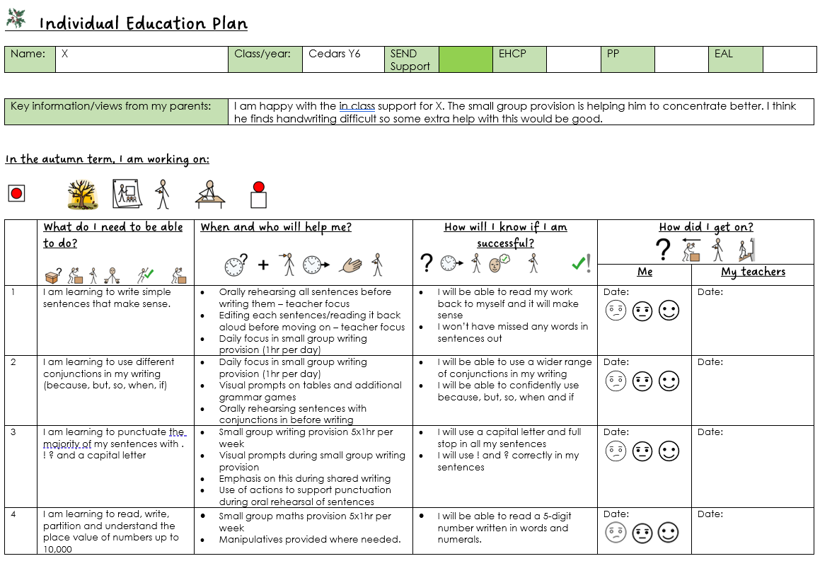
Example: Individual Education Plans

Slide 18
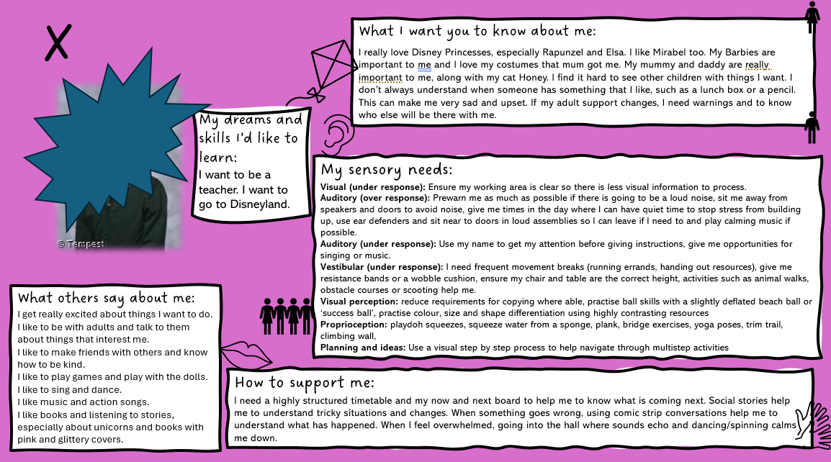
Example: One page profile

Slide 19
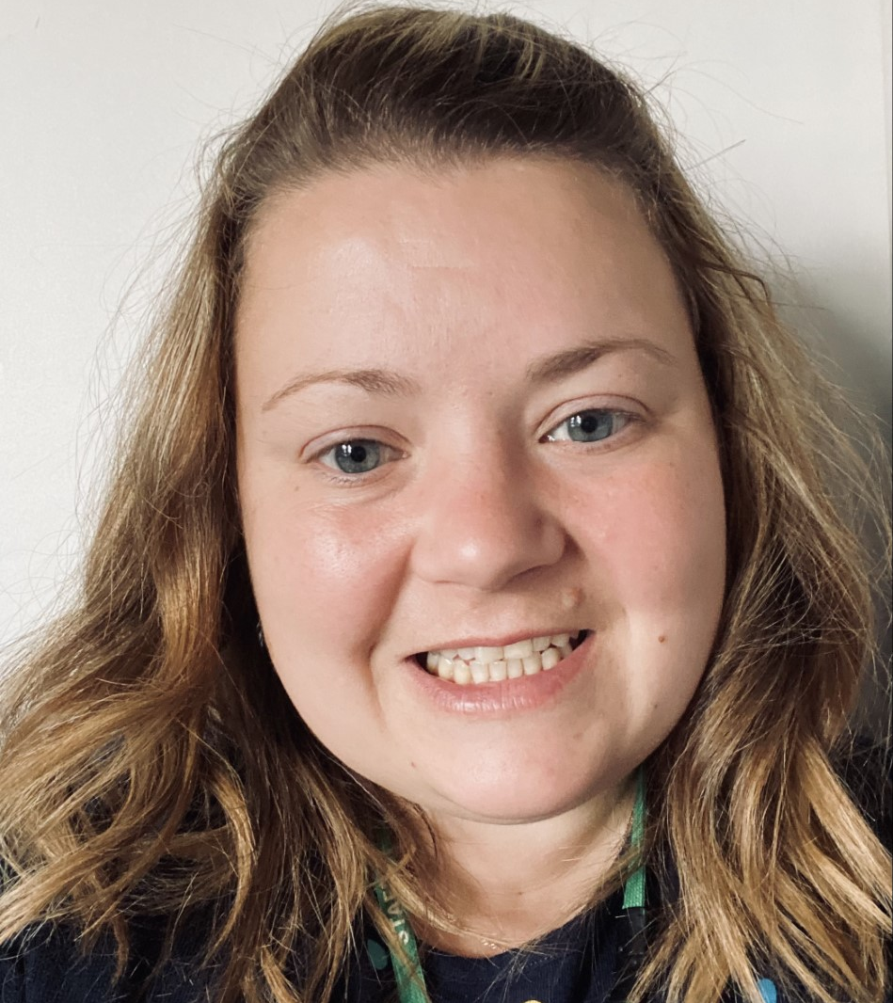
What is the role of the Inclusion Leader at Hawthorn?
Oversees the day-to-day operation of the Inclusion Policy.
Coordinates the provision for SEND children.
Liaises with parents of children with SEND.
Liaises with external agencies and professionals, early years providers and providers of a child’s next step in education.
Keeps records and paperwork up to date.
Makes applications as required to request additional support.
Attends Early Help Assessment (EHA) meetings for families with SEND.
Contact: fmartin@hawthorn.pfschools.org.uk

Slide 20

What support is there for families?
We work alongside families at Hawthorn through our Family Support Worker .
Ms Larkin is available each day and can be contacted via the school office, by calling the school on 01536 512204 or via email slarkin@hawthorn.pfschools.org.uk.
Ms Larkin can support on an informal level should you need some advice or someone to talk to about a problem which has emerged and that is impacting on your child or family.
Alternatively Ms Larkin can work with you on a more regular basis through an Early Help. This involves meetings on a regular basis – usually every 6 weeks - and an action plan involving other professionals.
Ms Larkin also provides wellbeing interventions for children across the school as well as drop in sessions for the children to discuss any worries or concerns.

Slide 21
What else do I need to know?
We would signpost you to the following policies which will give you further information.
Accessibility Policy
Inclusion Policy
Behaviour Policy
Intimate Care Policy
Children with Medical Needs Policy
Safeguarding Policy

Slide 22


What additional support is available for parents?
The Local Offer
Local Offer (northamptonshire.gov.uk)
https://www.northamptonshire.gov.uk/councilservices/children-families-education/send/local-offer/Pages/default.aspx
North Northants SEND IAS
Telephone number 0300 373 2532
Email address SENDIASS@northnorthants.gov.uk
Internet: https://www.iassnorthants.co.uk/Pages/home.aspx

Slide 23
How do we support children at Hawthorn when they move to the next phase of their education?
Pupils and parents are encouraged to consider all options for the next phase of education and the school will involve outside agencies, as appropriate, to ensure information is comprehensive but easily accessible and understandable. Accompanied visits to other providers may be arranged as appropriate. The school encourages parents of children with SEND to begin this process in year 5.
Support for the pupil in coming to terms with moving on is carefully planned and will include familiarisation visits. Pupils are included in all “class transition days” to the next phase but may also be offered additional transition visits.
We work hard to facilitate a smooth transition into our school from the previous phase of education and from our school into the next phase of education.
When a pupil with SEND is due to transfer to the next phase of education e.g. KS2 to KS3, the Inclusion Leader will arrange for all pupils with SEND to have additional visits where their questions can be answered in a small group situation.
All the information on the specific details of the individual needs of the pupil will be communicated to the next school's Inclusion Leader . Extra support is also available leading up to the transfer of the school the child may transfer to.
Timescale - the information is passed to the Inclusion Leader of the Secondary School in April/May who will then work collaboratively with staff to organise a transition package for the pupil. The additional visits usually take place in June and July. Parents are given a named contact at the next phase provider with whom the Inclusion Leader will liaise.

Slide 24
What if I’m not happy with the support my child is receiving at Hawthorn?
Contact Headteacher
Mrs Jacox
Contact Inclusion Leader
Mrs Martin
Speak to Class Teacher
Contact Chair of Governors
Richard Bailey
Follow the complaints procedure

